Slide 1
Centroids of Volumes and the Center of Mass via Composite Parts
Dr. Jacob Moore
Associate Professor of Mechanical Engineering
Penn State Mont Alto

Slide 2
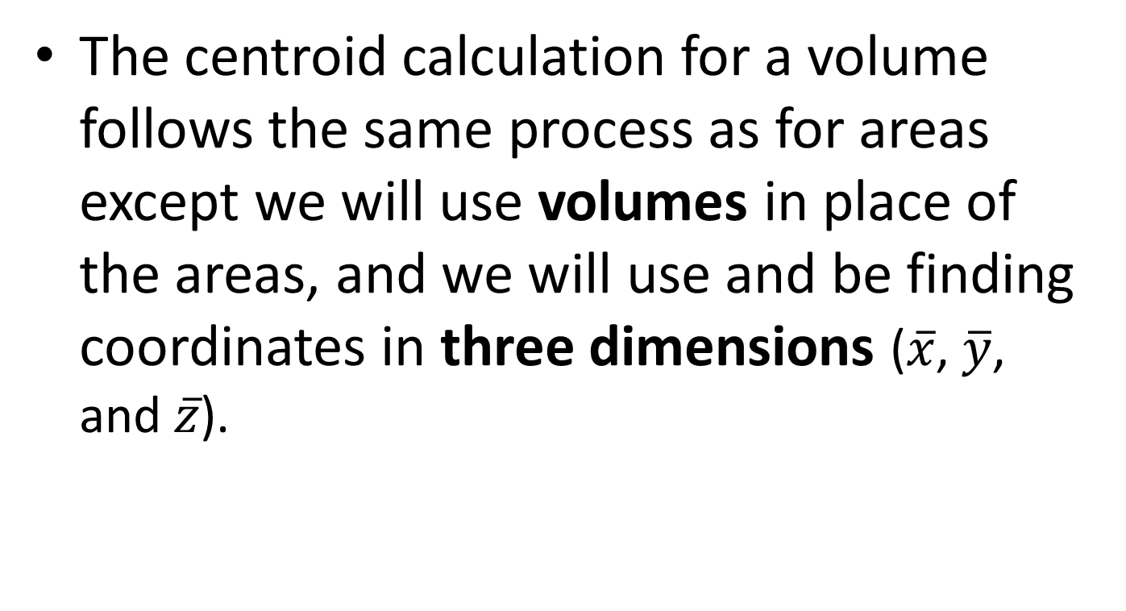
Centroid of a Volume via Composite Parts
The centroid calculation for a volume follows the same process as for areas except we will use volumes in place of the areas, and we will use and be finding coordinates in three dimensions ($\overline{x}$, $\overline{y}$, and $\overline{z}$).

Slide 3
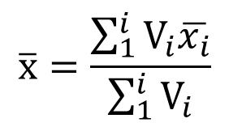
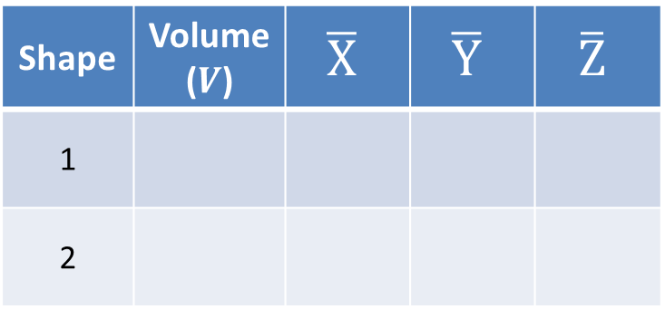
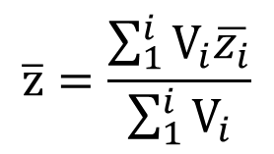
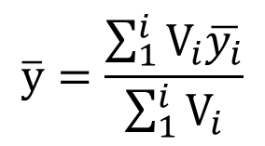
Centroids in 3D
Break the volume down into shapes we can look up in our table of centroids.
Cutouts and holes are represented by negative volumes
Remember to take into account the orientation and placement of the different pieces.
Shape | Volume ($V$) | $$\overline{X}$$ | $$\overline{Y}$$ | $$\overline{Z}$$
1
2
1
2
$$\overline{x}=\frac{\sum_{1}^{i}{V_{i}\overline{x_{i}}}}{\sum_{1}^{i}{V_{i}}}$$
$$\overline{y}=\frac{\sum_{1}^{i}{V_{i}\overline{y_{i}}}}{\sum_{1}^{i}{V_{i}}}$$
$$\overline{z}=\frac{\sum_{1}^{i}{V_{i}\overline{z_{i}}}}{\sum_{1}^{i}{V_{i}}}$$

Slide 4
Center of Mass
Finally, the center of mass calculation with the method of composite parts is the same as the centroid of a volume calculation, except we will be using mass in place of the volume.

Slide 5
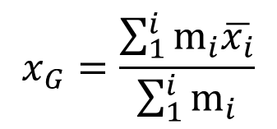
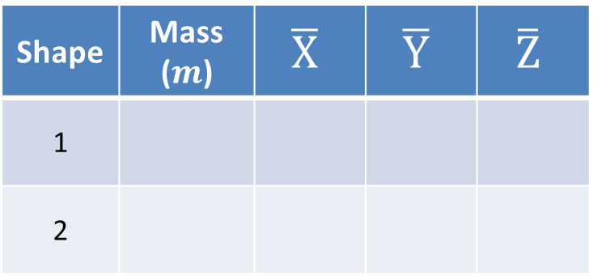
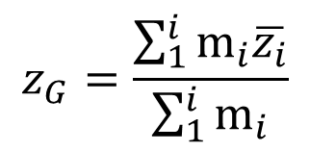
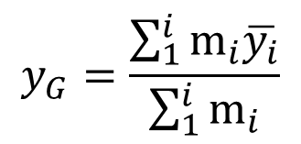
Center of Mass
For the Center of Mass we will use pretty much the same process except...
We will use the mass of each part in our table, which may be calculated as density times volume.
The mass of a cutout is the mass of material that would be removed.
1
Shape | Mass ($m$) | $$\overline{X}$$ | $$\overline{Y}$$ | $$\overline{Z}$$
1
2
2
$$x_{G}=\frac{\sum_{1}^{i}{m_{i}\overline{x_{i}}}}{\sum_{1}^{i}{m_{i}}}$$
$$y_{G}=\frac{\sum_{1}^{i}{m_{i}\overline{y_{i}}}}{\sum_{1}^{i}{m_{i}}}$$
$$z_{G}=\frac{\sum_{1}^{i}{m_{i}\overline{z_{i}}}}{\sum_{1}^{i}{m_{i}}}$$

Slide 6
Thanks for Watching
See other engineering mechanics videos and access the full tool at…

Slide 7
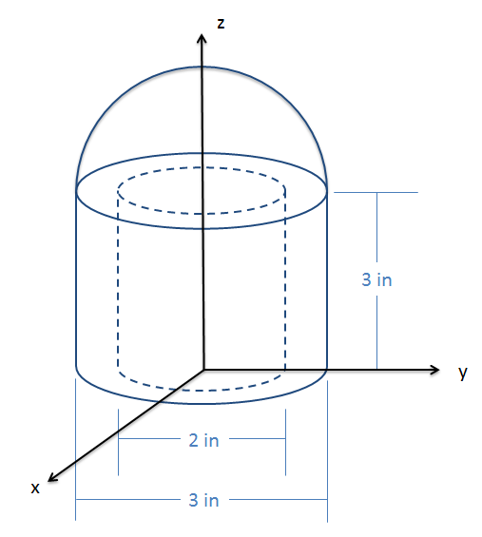
Worked Example
The shape shown to the right consists of a solid hemisphere on top of a hollowed-out cylinder. Determine the centroid coordinates of this volume.

Slide 8
Worked Example
A floating raft consists of a rectangular aluminum platform (assume negligible thickness) with a mass of 60 kg, on top of two plastic cylinders, each with a mass of 40 kg. Given the dimensions below, determine the location of the center of mass for the raft.
4 m
2 m
.75 m

Slide 9
Worked Example
A spherical tank with an outside diameter of two meters and a wall thickness of .01 meters is half filled with water. Determine the mass, and the height of the center of mass, for the half-filled tank as shown below.
2 m
Steel Density = 8050 kg/m³
Thickness of
tank = .01 m
Water Density = 1000 kg/m³
Z
X

